Slide 1
Raising of Kouga Dam: Improved Desktop Analysis Preliminary findings

Slide 2
Updated yield
Algoa Water Resources Bridging Study (DWA) – included an analysis of increase in yield from raised dam – report recently made available.
Hydrology was completely redone, meaning that all data (including rainfall, land use and calibrations) were updated
A satellite census followed by “ground truthing” was conducted
large areas of the catchment are covered by alien invasive plants of which a fair amount had already been cleared through Working for Water
Historical & stochastic yield analyses were performed with the Kouga Dam (both existing and raised options) in conjunction with the Loerie Dam further downstream. The AWSS was modelled as a whole.
Raising by 10.5m, 16.5m and 19.8m was considered.
No EWR releases from the Kouga Dam were modelled, which is a shortcoming. This may reduce the estimated yields.

Slide 3
Updated yield (cont’d)
Scenario | Firm Yield (Mm³/a) | Incremental yield (Mm³/a)
Kouga Dam at current 126 Mm³ | 66.7 | -
Raising of Kouga Dam:
Kouga raised to 200 Mm³ (+74Mm³) | 74.4 | + 7.7
Kouga raised to 255 Mm³ (+129Mm³) | 79.0 | + 12.3
Kouga raised to 293 Mm³ (+167Mm³) | 84.0 | + 17.3
Additional scenarios for clearing invasive alien vegetation and stopping opportunistic irrigation in the catchment can provide small additional yields

Slide 4
Updated cost estimate
Existing 69 m high concrete arch dam on the Kouga River
Full Supply Level - 149.36 masl
Full Supply Capacity – 126 million m³
Full Supply Area – 560 ha
Dam was designed to be raised but foundation problems (among others) have precluded this option
Alternative is to construct a new concrete gravity dam directly downstream of the existing one
Would use existing wall as upstream shutter / coffer dam
Cost savings foreseen by using existing infrastructure
Synergy between cost of Dam Safety work and that of the new dam must be investigated

Slide 5
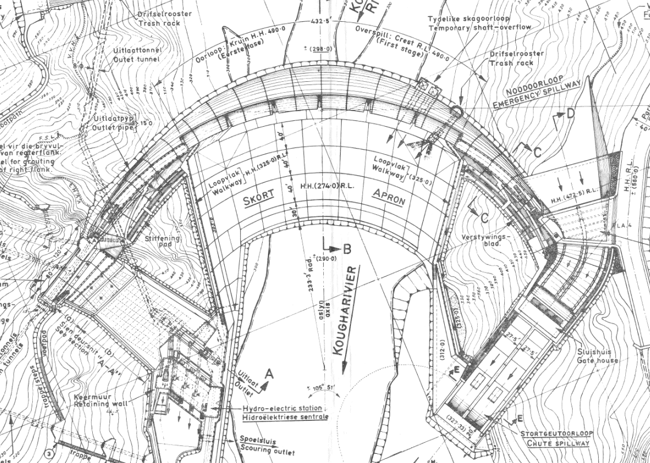
Updated cost estimate (cont’d)
Assumption used in the cost model
First order cost model based on basic quantities (concrete volume, excavation, formwork) and unit rates multiplied by an all-in factor
Existing dam and its services to be reused in the new dam as far as possible
Dam type: concrete gravity constructed with RCC
Costs of land purchase or road re-alignments/other affected infrastructure not yet included
Unit cost of the dam compares well with other recent dams

Slide 6
Updated cost estimate (cont’d)
Raising option | 200 Mm³, +10.5 m | 255 Mm³, +16.5 m | 293 Mm³, +19.8 m
Cost (R million) | R 1 250 | R 1 461 | R 1 602
Yield (Mm³/a) | 74.4 (+7.7) | 79.0 (+12.3) | 84.0 (+17.3)
URV @ 6% (R/m³) | 12.14 | 8.84 | 6.89

Slide 7
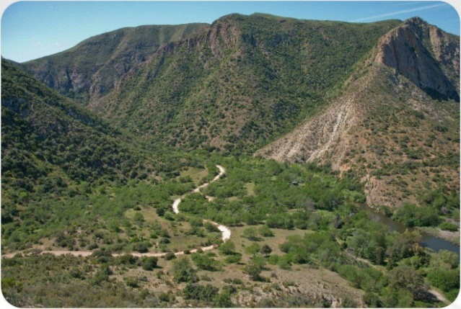
Potential Environmental and Social Impacts
The following aspects require detailed assessment to determine significance of impact:
Critical Biodiversity Areas affected – areas identified for protection ito biodiversity value
Vulnerable vegetation type (Baviaanskloof Thicket Savanna) affected – need to determine significance ito conservation targets
Potential loss of Rocky Refugia and Cliff habitat as well as riverine wetlands
Change in flood regime with potential ecological impacts downstream
Changes in water quality from inundation of vegetation and from siltation

Slide 8
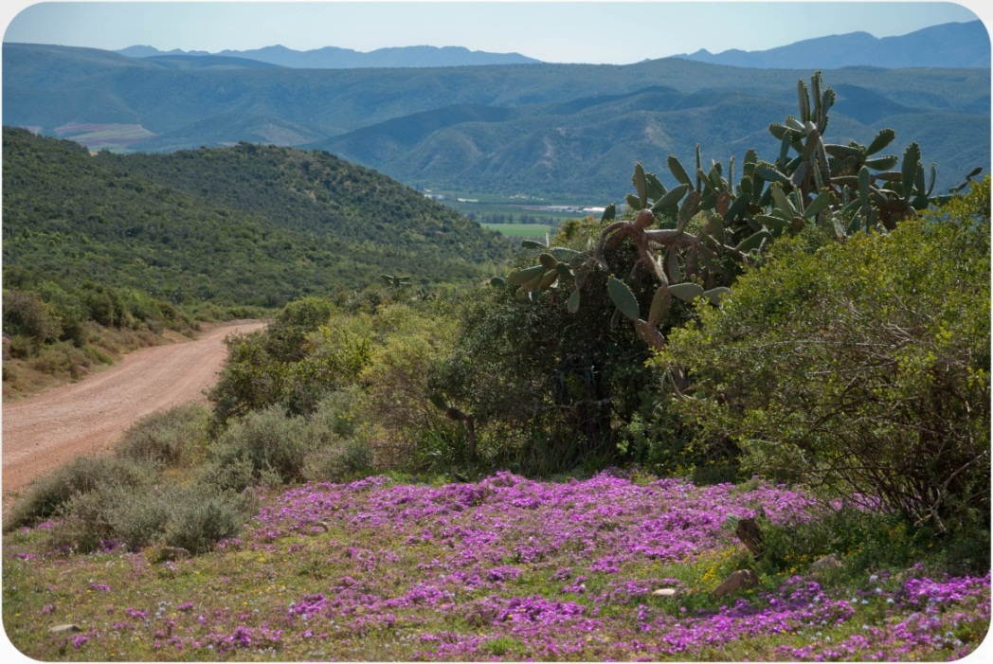
Environmental and Social Risk
Less dilution of saline flows from the Groot River – Reserve requirements
Need to relocate part of road built by Thomas Bain – historical resource topographically constrained ito rerouting
Need to relocate Doodsklip and Rooihoek Wilderness camps and Smitskraal campsite
Impact of additional area for dam below existing dam (loss of land and construction impacts)
Social impacts on local communities - of construction teams in area
Impacts in terms of tourism and the local economy

Slide 9
Conclusions
Raising is relatively costly due to the reduced yield
Environmental flows have not been taken into account
Dam safety requirements & cost, and how it relates to the potential raising, is not yet known
Environmental impacts may trigger significant opposition from environmental groups
There are still significant uncertainties
Long processes are expected wrt implementation

